Slide 1

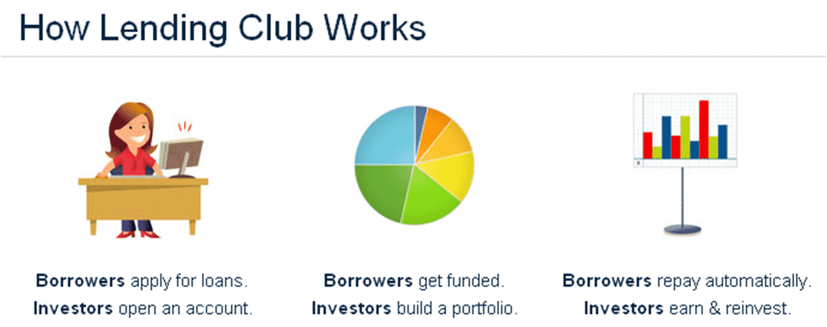
Online Lending Club
Prepared By:
Khalid Mohamad Aladin Hafez Omar
Email:khalidomarasu@gmail.com
Nadeem Akhter
Email:MNadeemAkhter@hotmail.com

Slide 2
Outline:
Lending Club is a marketplace in US for personal loans that matches borrowers who are seeking a loan with several investors looking to lend money and make a return.
Goals
Be Profitable
Have better understanding of its customers
Approve profitable loans and reject risky loans
Concerns
Approving Risky loans
Losing investments or investors
Requirements
EDA on previous Data to Understand variables leading to Risky Loans
Predict bad loans using those driving variables
Objectives:
The company wants to understand the driving factors behind a defaulted loan default, i.e. the variables which are strong indicators of default. The company can utilize this knowledge for its portfolio and risk assessment.
We will analyze the past dataset by using EDA to understand customer and loan patterns with respect to their influence on not repaying loan on time or simply defaulting the loan.

Slide 3

EDA Road Track
Analyze and impute empty values:
Disguised Missing values
Significant number of Missing values in a row/column
Partial missing values
Fix Invalid Values:
Incorrect data types
Correct values beyond range
Validate internal rules
Data Cleaning
Fixing Columns:
Delete Unnecessary columns (or irrelative (behavioral) to defaulter analysis)
Deleting Unique Identifier columns
Deleting columns with more than 85% Null values.
Delete duplicates if any.
Bivariate Analysis:
Understanding how combination of 2 variables estimates a defaulted loan.
Check correlations
Univariate Analysis
Frequency, Distributions
(Categorical and Numerical)
2
2.2
3
5
Conclude driving variables.
Conclusion
7
1
2.1
2.3
4
6
Data Sourcing and Understanding:
The Data has 39,717 rows and 111 columns
The data set available is loans.csv which represents the data for 4 years.
Understanding columns using dictionary
Fixing Rows & Identifying and Treating Outliers:
Extra rows -> Outliers were deleted and all values with Current in loan_status column were deleted
Derived Metrics
Data/Business/Type):
Creating Bins:
Segmented Analysis
Multivariate Analysis

Slide 4
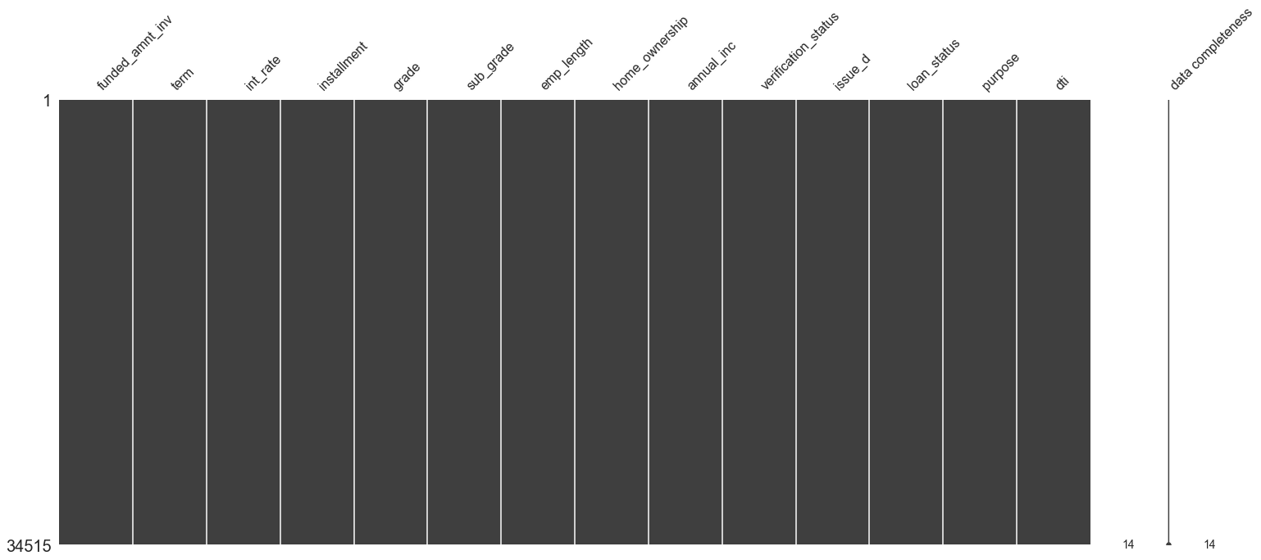
Data Understanding and Cleaning:
Understanding:
The data provided is loans.csv which represents the data collected from years 2007 to 2011
There are 39,717 rows and 111 columns in this dataset.
The data types are as follows 74 float64, 24 objects & 13 int64
The data have 56 columns with 85% or more null values.
Percentage of null values | No. of columns
0 | 15% or less | 53
1 | 85% or more | 56
Cleaning:
Columns with more than 85% null values, have unique identifier values, behavioral variables.. Were all dropped.
Outliers identified
Extra rows -> Outliers were deleted and all values with Current in loan_status column were deleted.
Analyze and impute empty values (Disguised Missing values, Significant number of Missing values in a row/column ,Partial missing values)
Derived Metrics( Data/Business/Type, Creating Bins)
Data Variables Types Available:
Loan Characteristics such as funded_amnt_inv, term, purpose which shows the information about the loan that will help us in finding loan default. (Main focus)
Demographic Variables such as age, employment title, relationship status (Not used)
Behavioral Variables such as inq_last_6mths, total_pymnt_inv, collection_recovery_fee this information is provided after the loan is approved thus (Not Used).
Null Matrix and remaining columns after cleaning the data.

Slide 5
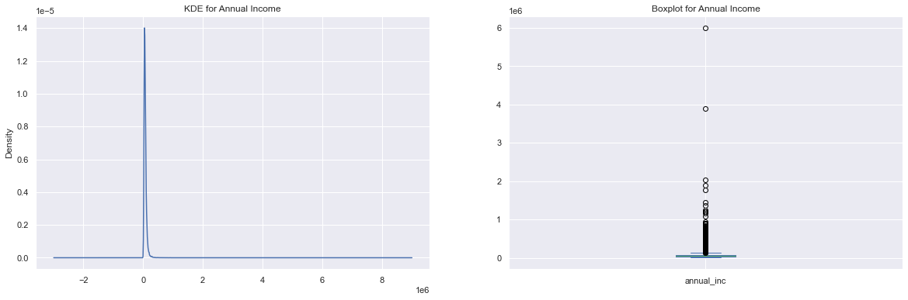
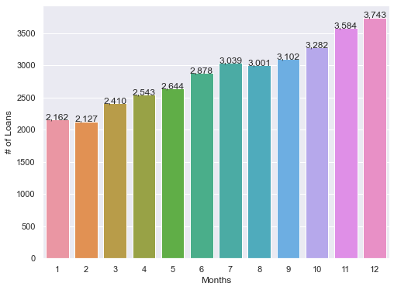
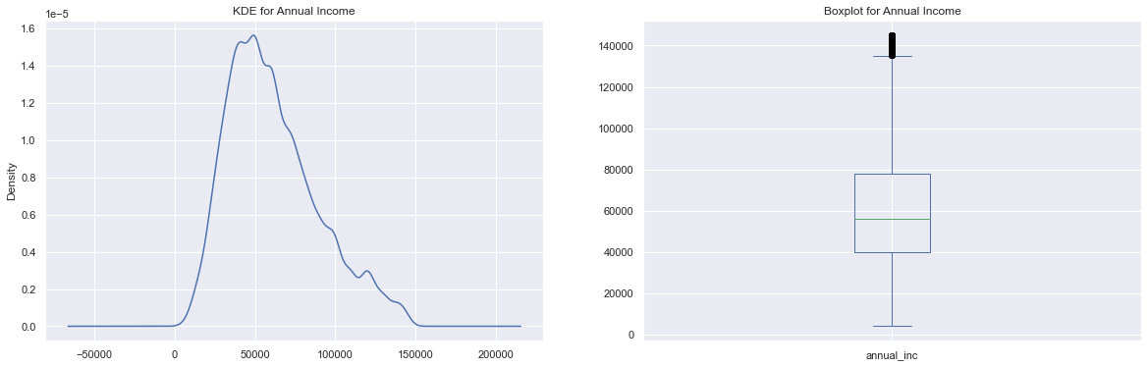
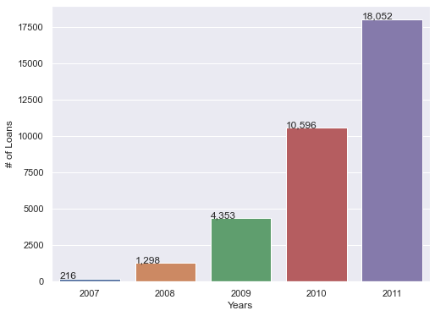
Outlier treatment and Derived Metrics:
New derived variable: issue_d_Month from issue_d column
This shows that the number of loans approved in December is the maximum
Before treating outliers in annual income column:
After treating outliers in annual income column:
New derived variable: issue_d_Year from issue_d column
The number of loans issued by the lending club is increasing each year in 2011 it had the maximum no. of loans.

Slide 6

Data Analysis:
Univariate
Categorical
Continuous
Bivariate
Continuous
Categorical
Multivariate

Slide 7
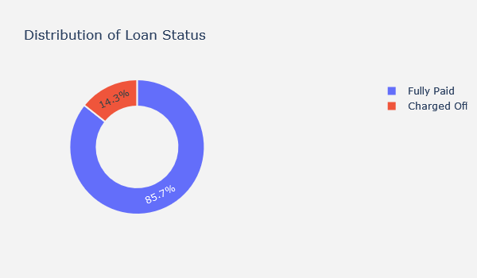
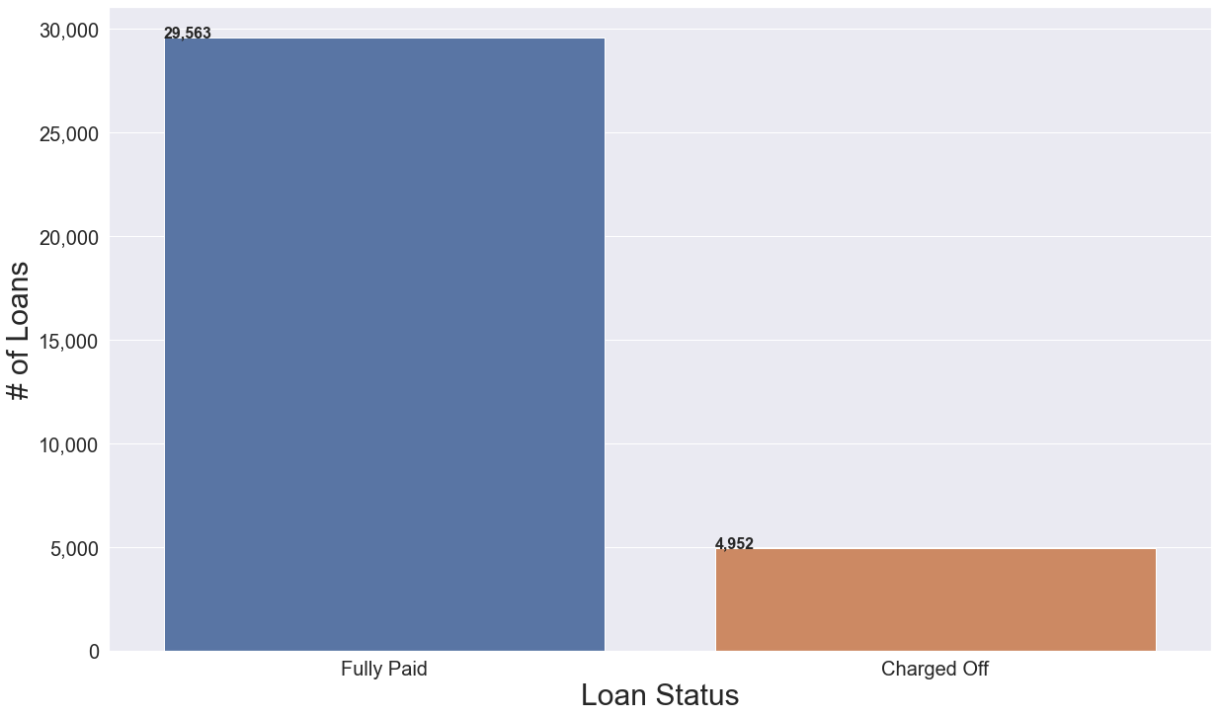
Univariate Analysis: - Loan Status
-The total number of defaulted loans from 2007 to 2011 is 4,999 Loans which represents 14.4% of the whole dataset:
- 85.7 % of the loans issued are fully paid.

Slide 8
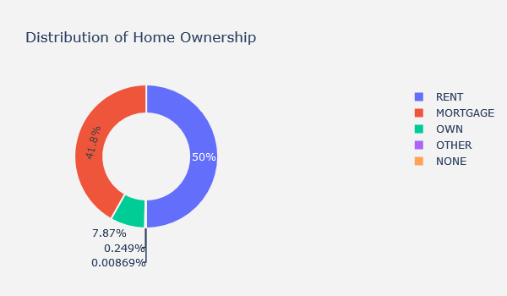
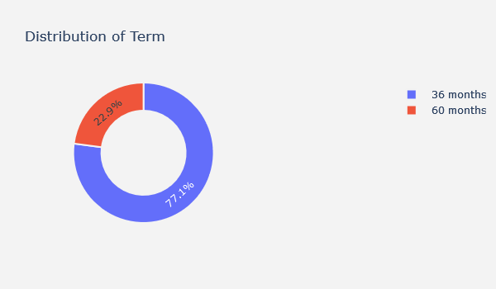
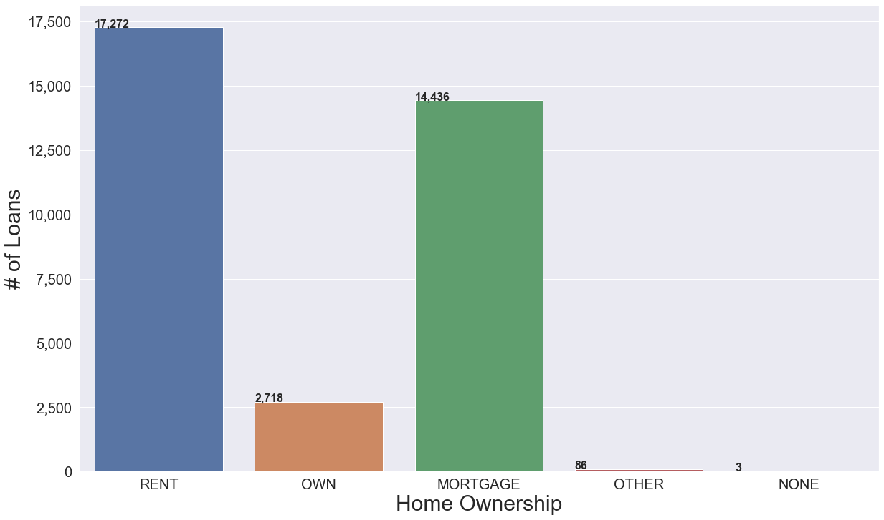
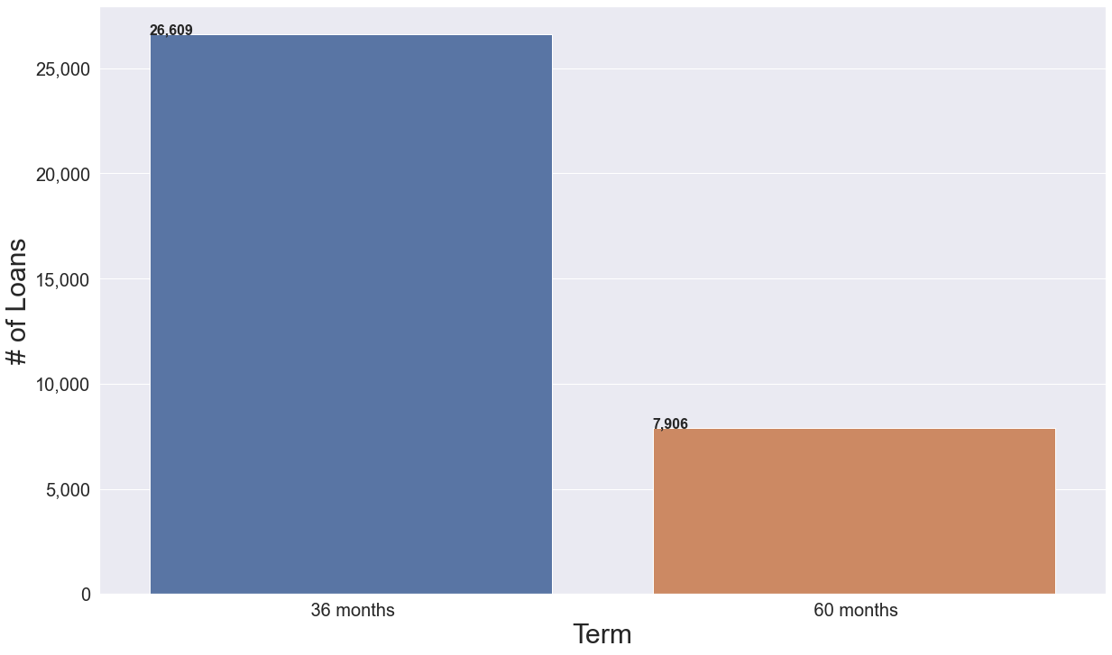
Univariate Analysis: - Term – Home Ownership
We can infer from above that 50% of loan borrowers are renting 41.8% have mortgaged their houses and only 7.87% of borrwers own a house:
We can conclude that people who own most probably have good cash flow thus 91.8 % of loan borrowers are those who rent houses or mortgaged their houses:
77.1% of the terms issued are issued on a short-term plan of 36 months and only 22.9% were issued on a long-term plan of 60 months.
We can conclude that most of the borrowers take loans on shorter payment plans as an assumption reason of higher interest charged on long term plans.

Slide 9
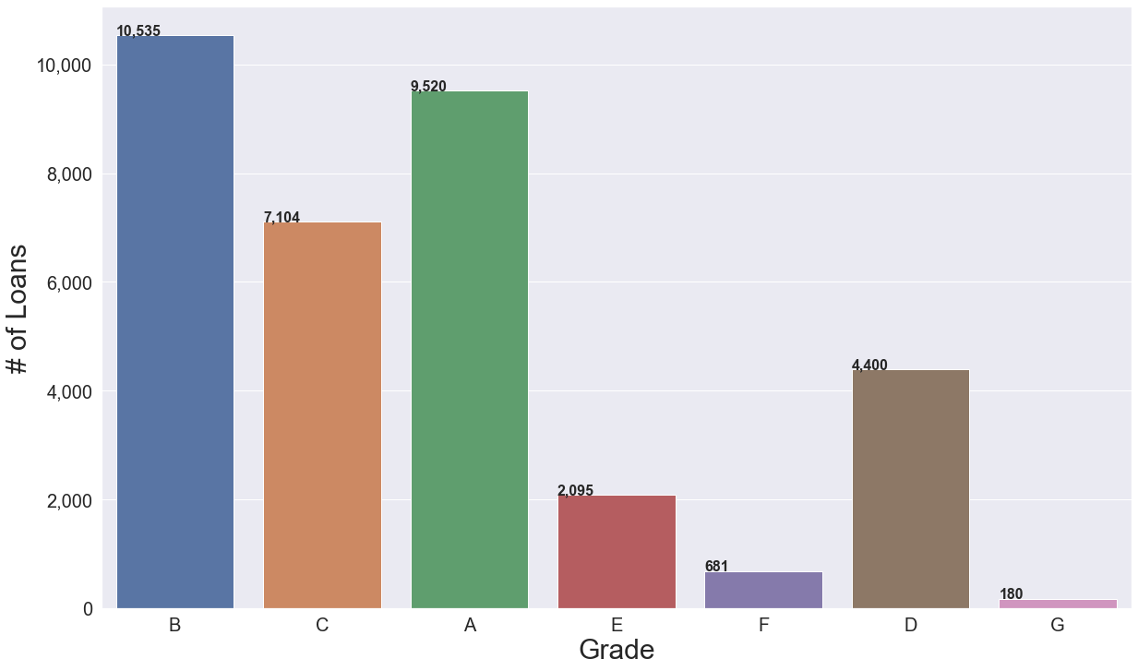
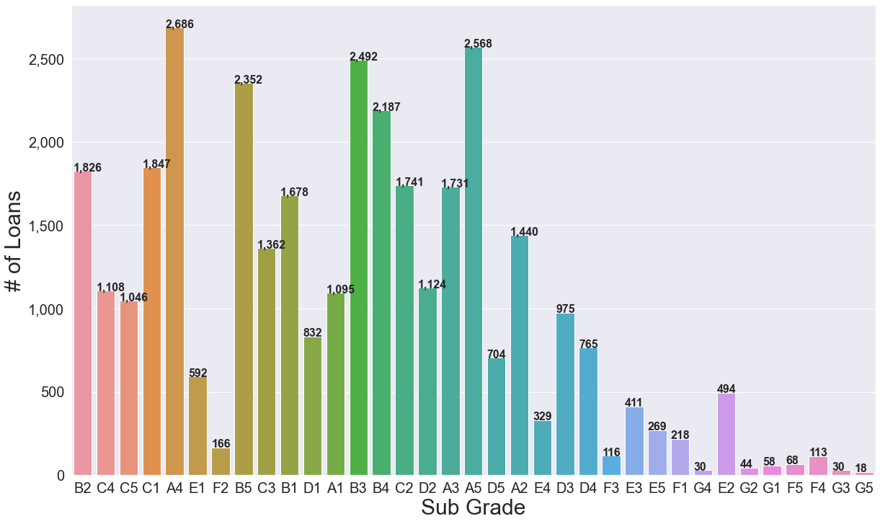
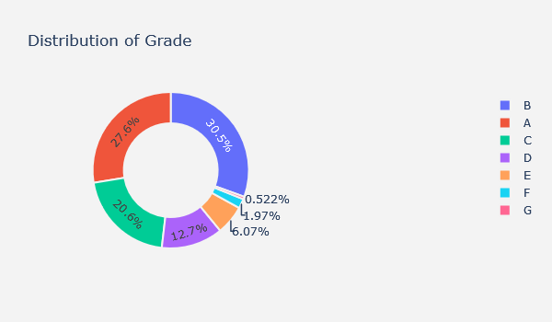
Univariate Analysis: - Grades – Sub Grades
Only 18 loans were issued on loan subgrade G5 is a minority with only while the most count is A4 and A5 respectively.
Most of the loans were issued to subgrades A1 to A5 B1 to B5 and C1 to C5.
Grade B represents 30.5% of the total loans issued followed by A 27.6% and then C,D,E,F respectively.
We can conclude that 78% of loans issued lies in range of grades A to C.
Grades F,G represents a minority (2.5%) across the dataset.

Slide 10
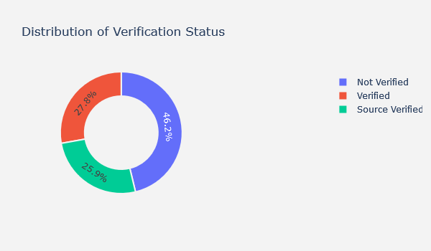
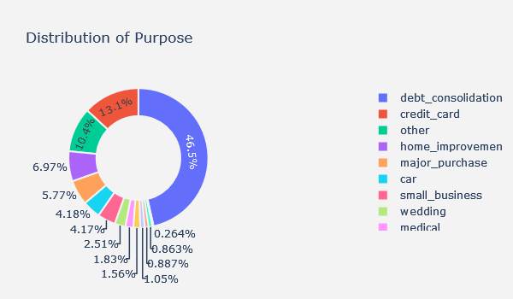
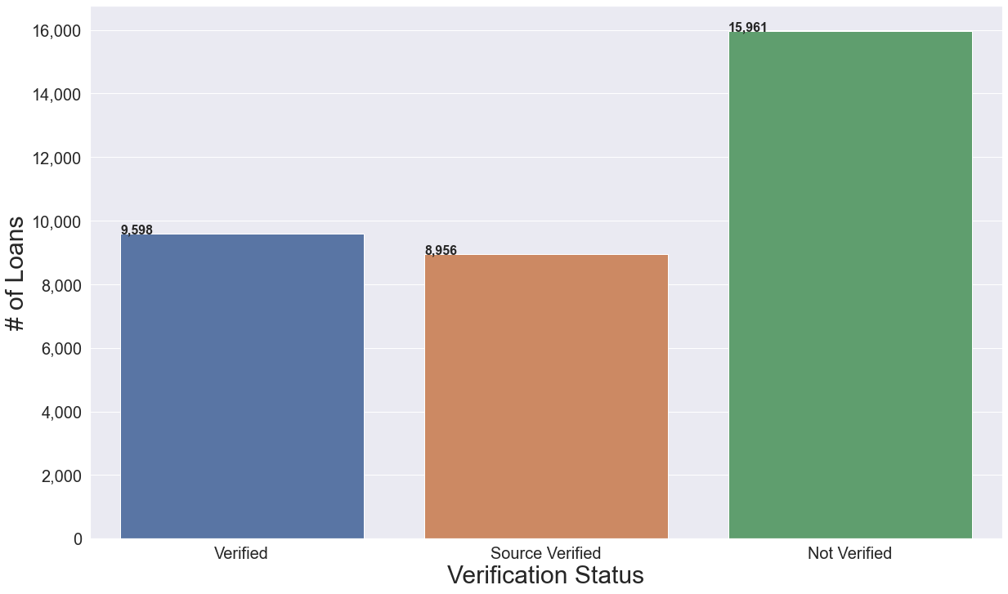
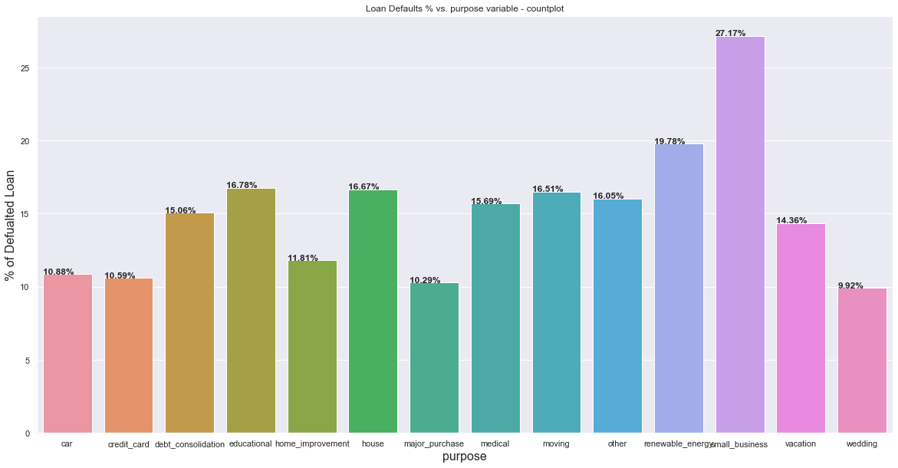
Univariate Analysis: - Purpose – Verification Status
Almost half of the loans issued were issued to borrowers with incomes not verified.
Quarter of the loans were issued to income source verified customers and 27.8% of the loans were issued to verified income customer.
The plot shows normal distribution we can infer 53.8% of the loan were issued to Verified Income sources (Source, Verified) and 46.2% were issued to customers with Un-verified income sources.
Almost 50% of the borrowers took loan for the purpose of debt consolidation
We can conclude that 53.5% of the data is distributed between 13 different purposes.
The least count goes to loans for the purpose of renewable energy.

Slide 11
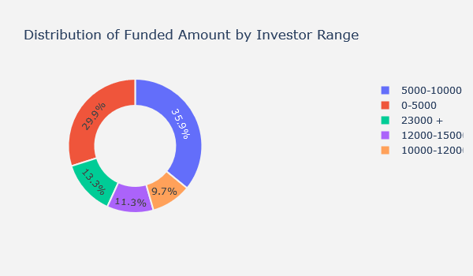
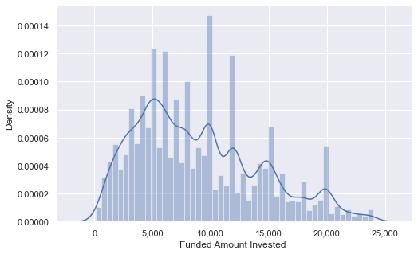
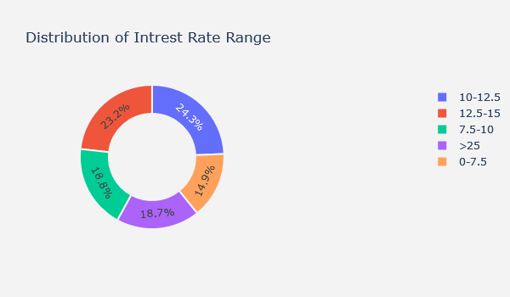
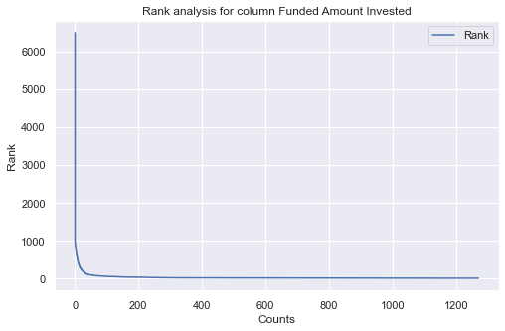
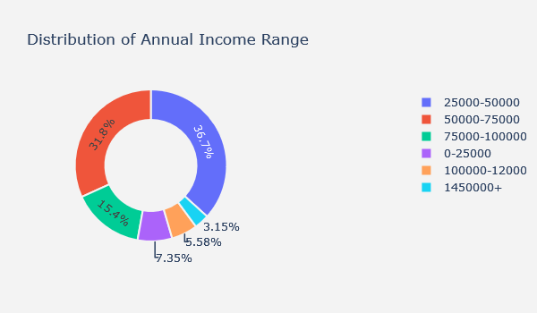
Univariate Analysis: - Funded amount by investor – interest rate range - Annual income range
65.8% of investors invested from 0 to 10,000
13.3% of investors gave more than 23k USD to borrowers.
Only 10% of the loans issued range between 10k to 12k.
50% of the loans issued had an interest rate of 10 to 15%.
The maximum interest rate was 25% and more and it covers 18.7 % of the total loans issued.
The lowest interest charged on loans ranges between 0 to 7.5% and it represent 18.8% if the loans issued.
Only 15% of the loans issued had an interest rate less than 7.5%
Almost 37% of the clients make 25k to 50k each year.
67% of the borrower's annual salary ranges between 25k to 75K
15% of the borrowers have a salary range of 75k to 100k yearly.
7.35% of the clients make less than 25K a year.
There are few values with higher rank (0 as the highest rank) as the line is almost vertical from around 0 to 10 counts
There are higher number of low rank values as the line is almost flat after around 10 counts

Slide 12
Bivariate Analysis

Slide 13
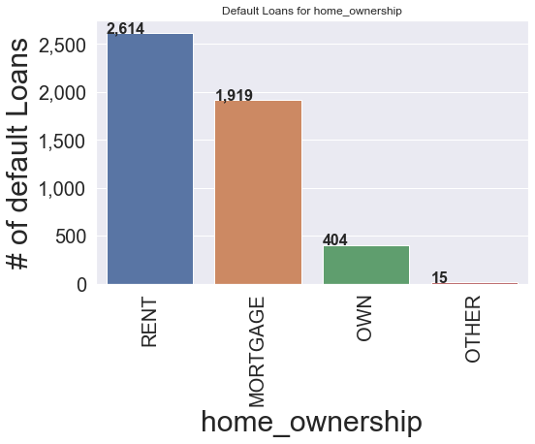
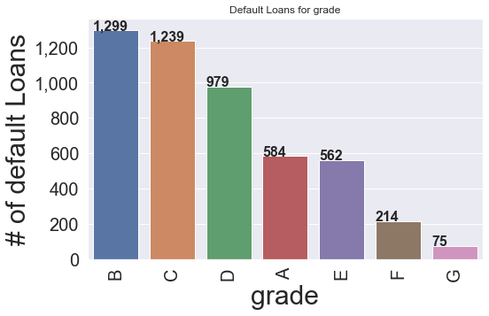
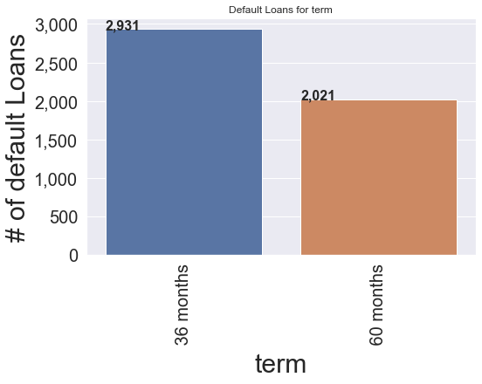
Categorical Analysis (grade, home, term)
Loans issued with short term tend to have more # of defaults than long term loans.
Clients with rented homes has the highest # of loan default. Be careful when issuing a loan client with rented house.
Grade B has the highest # of loan default.

Slide 14
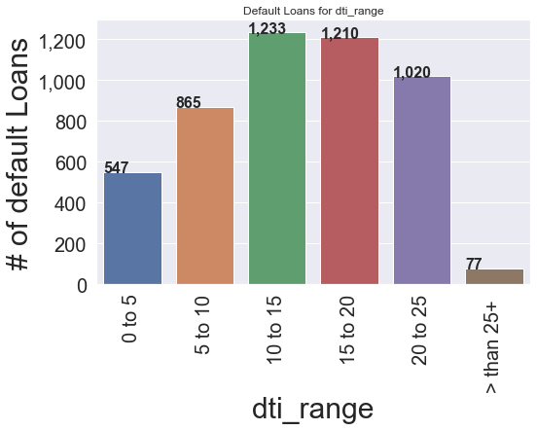
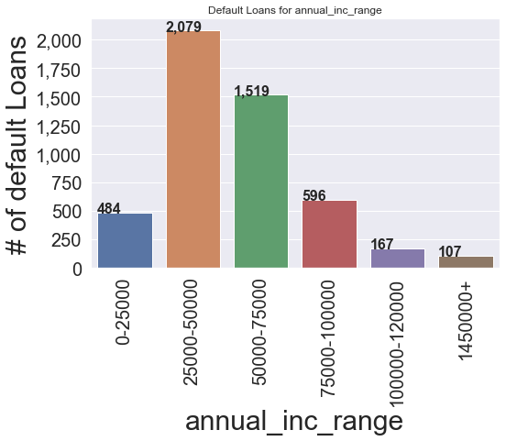
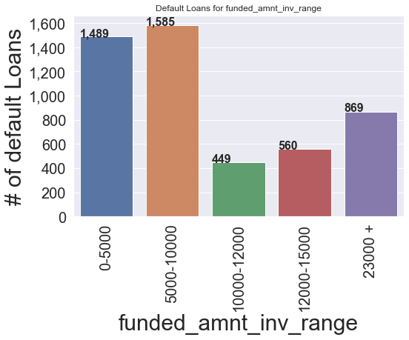
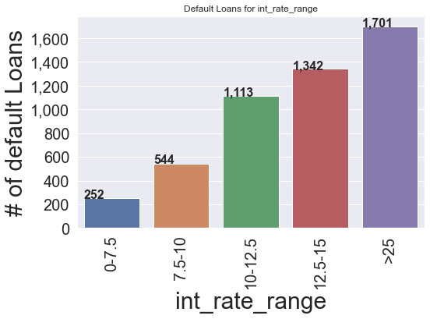
Categorical - Numerical Analysis (annual income- dti- invested amount and interest rate)
Clients with annual income range between 25 to 50K USD tend to have the highest count of defaulted loans. Take care of this category.
Clients with dti ratio of greater than 5 and less than 25 have high count of loan defaults.
Do not issue loans to clients with dti ratio >than 5
Most of the loans defaulted are for the small amounts. As most probably low amount are approved to people with lower grades and less securities thus, they can't pay back.
Do not issue loans with interest rate 25% and more it has high default ratio.

Slide 15
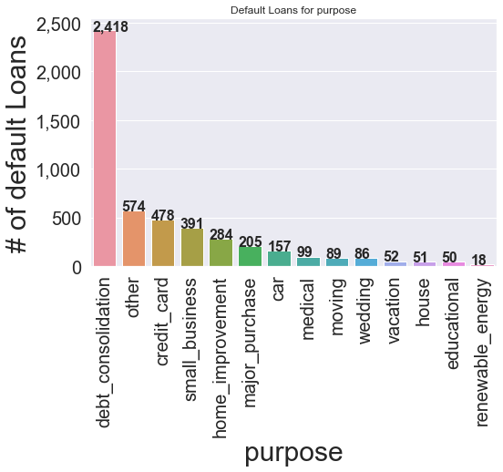
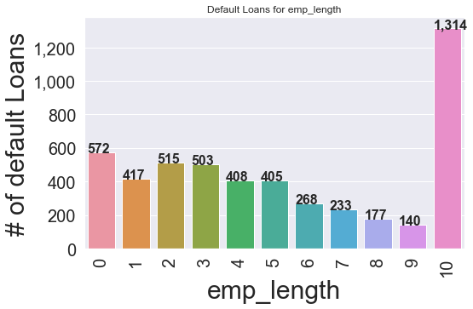
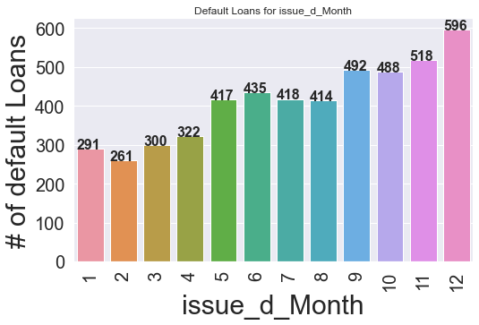
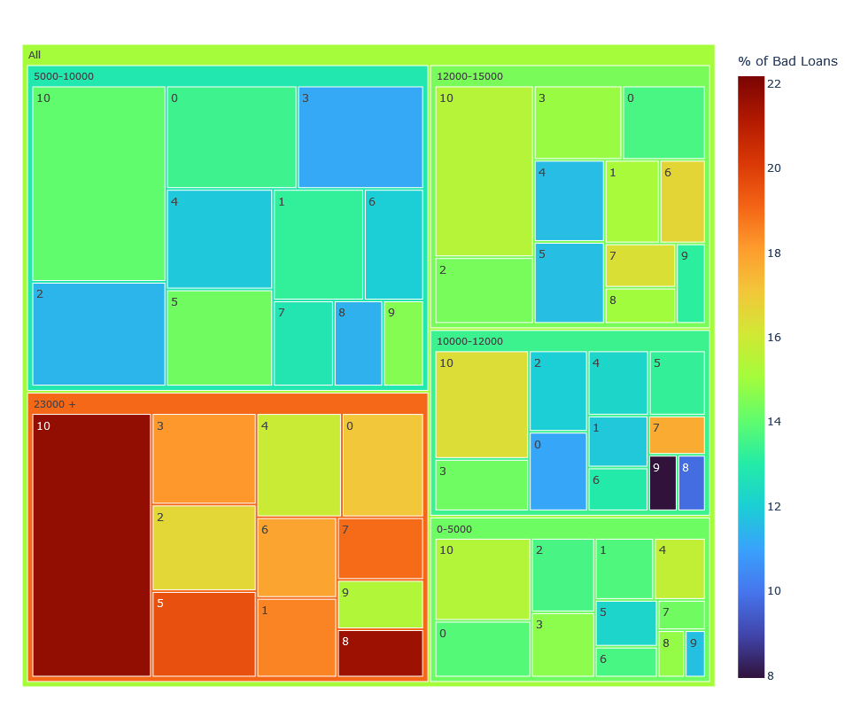
Categorical - Numerical Analysis (annual income- dti- invested amount and interest rate)
As the year ends the number of defaulted loans increases.
The highest chance for a loan to default is for debt consolidation.
The highest number of loan defaults are for employees with 10 or more years this could be a reason as people are mostly retired no source of income.

Slide 16
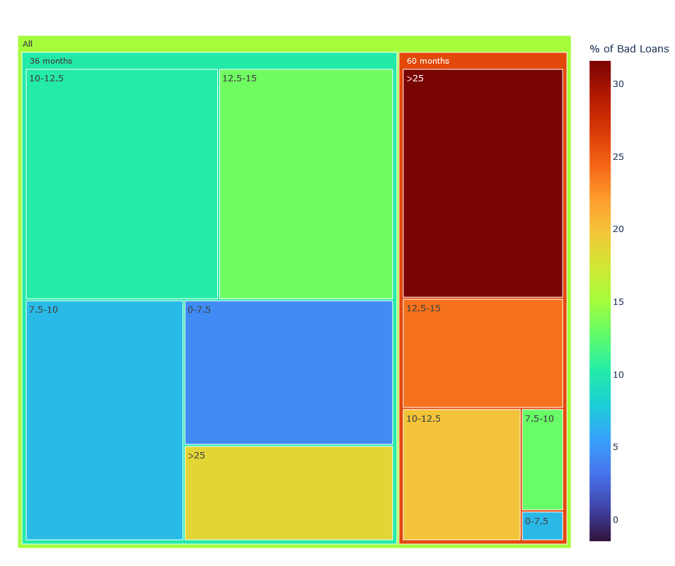
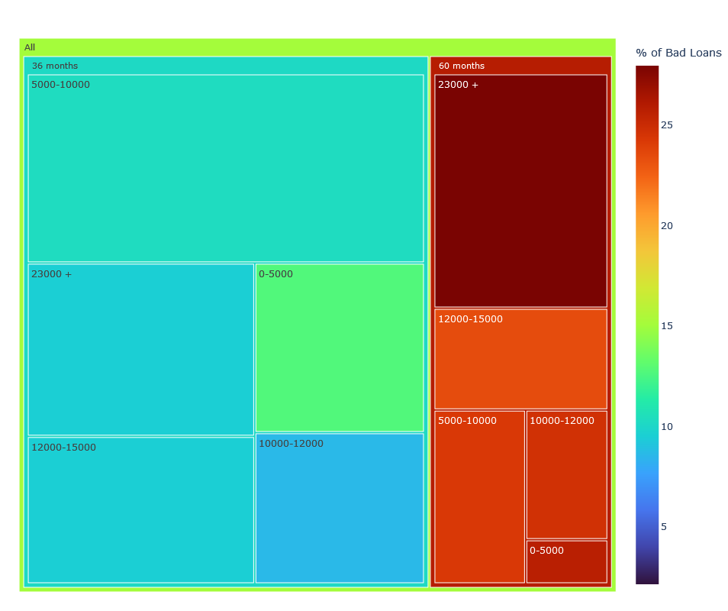
Variables term and sublevel int_rate_range Please note the size of the box is based on the funded_amnt_inv value and color is based on the % of bad loans
1.term.vs. int_rate
All loans issued with 25% or higher interest with respect to all the different terms length (36 or 60 months) lead to a high percentage of loan default.
2 vs. funded_inv_amnt
To reduce future loss do not issue any long-term loans (60 months) in any amount unless you make take all necessary precautions.
#3. vs. annual_inc
To reduce future loss do not issue short term loans (36 months) if the client annual income is less than 25K.
To conclude and reduce future loss do not issue long term loans with a period of 60 months.
This is a strong deriving variable to loan default.

Slide 17
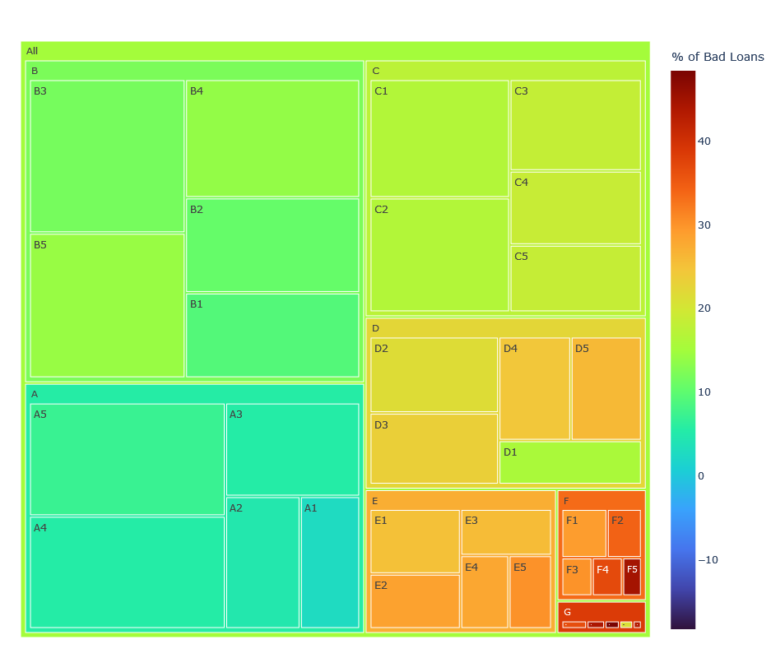
Findings Grade Bivariate
1.vs. funded_amnt_inv
>* All loans issued with 25% or higher intrest with respect to all varaibles lead to a high percentage of loan default.
#2 vs. annual income
>* To reduce loss do not issue loans with intrest rate of 12.5% or higher to clients with annual income less than 50k.
#3. vs. term
>* To reduce loss do not issue long term loans if the loan intrest rate is 10% or higher.
#4 vs. purpose
>* To reduce loss do not issue loans with intrest rate of 10% or higher for the purpose of small business and education.
>* To reduce loss do not issue loans with intrest rate of 12.5% or higher for the purpose of debt consolidation & renewable energy.
#5.vs. Grade
>* To reduce loss do not issue loans with high intrest rates above 25% for loan grades (C to G) as they show a high percentage (24-38%) of loan defaluts:
#6.vs. sub_grade
>* All sub grades show similar behaviour to grades E1 shows a high percetage of loan default for the loans issued with 25% intrest rate:
Conclusion
>* To conclude and reduce future loss do not issue loans with intrest rate of 25% or higher to any client as it leads to a default.
>>* This is a strong derivng variable to loan default.

Slide 18
Grade across all variables.
1.grade.vs. int_rate
>* All loans issued with 25% or higher intrest with respect to all loan grades lead to a high percentage of loan default. >* Most of the loans issued with 25% or higher have a loan grade ranging (C to G)
#2 vs. funded_inv_amnt
>* To reduce future loss do not issue loans for grades(E to G) for all invested fund_amnt_inv.
>*Loan grades f-g shows high % of loan defaults
#3. vs. annual_inc
>* To reduce future loss do not issue loans for grades(E to G) for all clients annual income ranges.
>* To reduce future loss do not issue loans for people with annual inc less than 100k on grades E to G.
#4 vs. purpose
>* To reduce future loss do not issue loans for the purpose of debt consolidation, credit card, medical, house , vacation, educational and other for loan grades (E to F
>* To reduce future loss do not issue short term loans for the purpose of small business.
#5.vs. Grade
>* To reduce future loss do not issue loans for the purpose of small business for loan grades (B to F)
>* To reduce future loss do not issue loans for the purpose of others, debt consolidation, educational etc.. for loan grades (C to F)
#6.vs. sub_grade
>* All sub grades show similar behaviour to grades:
>* To conclude and reduce future loss do not issue loans for the purpose of debt consolidation if the loan grade is between (C to F).
>>* This is a drivng variable to loan default.

Slide 19
Multivariate Analysis

Slide 20
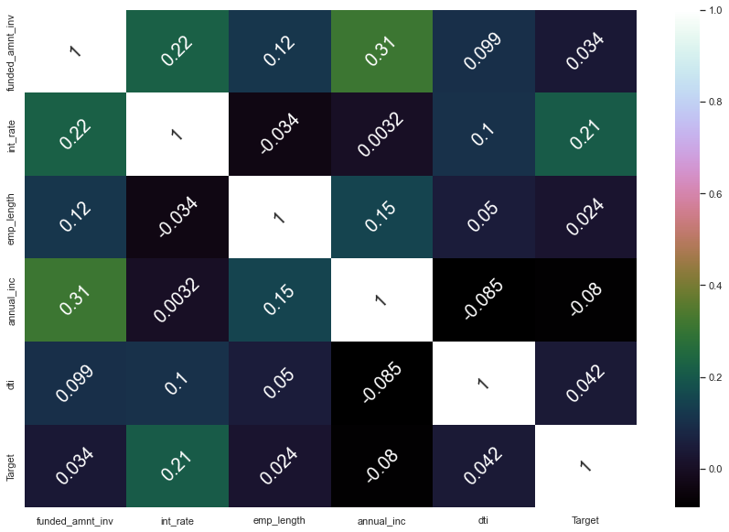
Multivariate analysis of numerical features
There is a positive correlation between the amount funded by investor the client annual income and the interest rate.
To conclude that as the annual income of a borrower increase the investor is more willingly to fund more money.

Slide 21
Conclusion

Slide 22
14% of the data is defaulted loans
Greater than 25% interest rate has higher chances of default
60 Month Term loan has higher chances of default
Grade D and higher has higher chances of default
Loans take for small business and Debit consolidation has higher chances of default
High amount of loans for income less than 100K has higher chances of default
To reduce loss do not issue long term loans if the loan intrest rate is 10% or higher.
Small business shows the highest % of a loan default, the company have to selectively pick applicants in this category.
To conclude and reduce future loss do not issue loans for the purpose of debt consolidation if the loan grade is between (C to F).

Slide 23
Deriving Variables to Loan Default.
Interest Rate
Funded Investor amount
Annual Income
Term
Grade
Purpose

Slide 24
Investor Recommendations.
Do not invest in loans with interest rate 25% and more it has high default ratio.
Do not invest in short term loans (36 months) if the client annual income is less than 25K.
Try to avoid investing in loans issued to employees with 10 or more years as they represent a risk of ending as a default and it's recommended to approve only small amounts.
Do not invest loans with interest rate of 12.5% or higher to clients with annual income less than 50k.
Groups A and B are the safest to invest.
Invest in loans were people own their house.
Do not invest in loans of purpose of small business as it a high risk.

